Slide 1

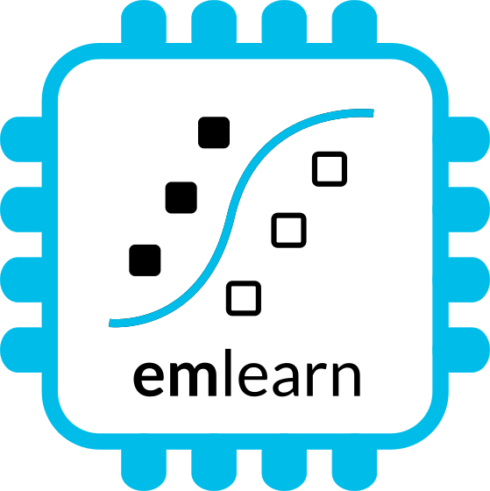
Machine Learning on Microcontrollers
using MicroPython and emlearn https://github.com/emlearn/emlearn-micropython
Jon Nordby jononor@gmail.com
PyData Berlin / PyCon.de 2024
Notes:
Hi everyone. Glad to see so many being curious about microcontrollers! I have with be a munch of MicroPython compatible devices today. So if anyone is interested in borrowing for trying it out, we can do that after the session. On the A floor, next to the tutorial rooms. And one lucky person that asks a question will get one of these devices to take home!

Slide 2
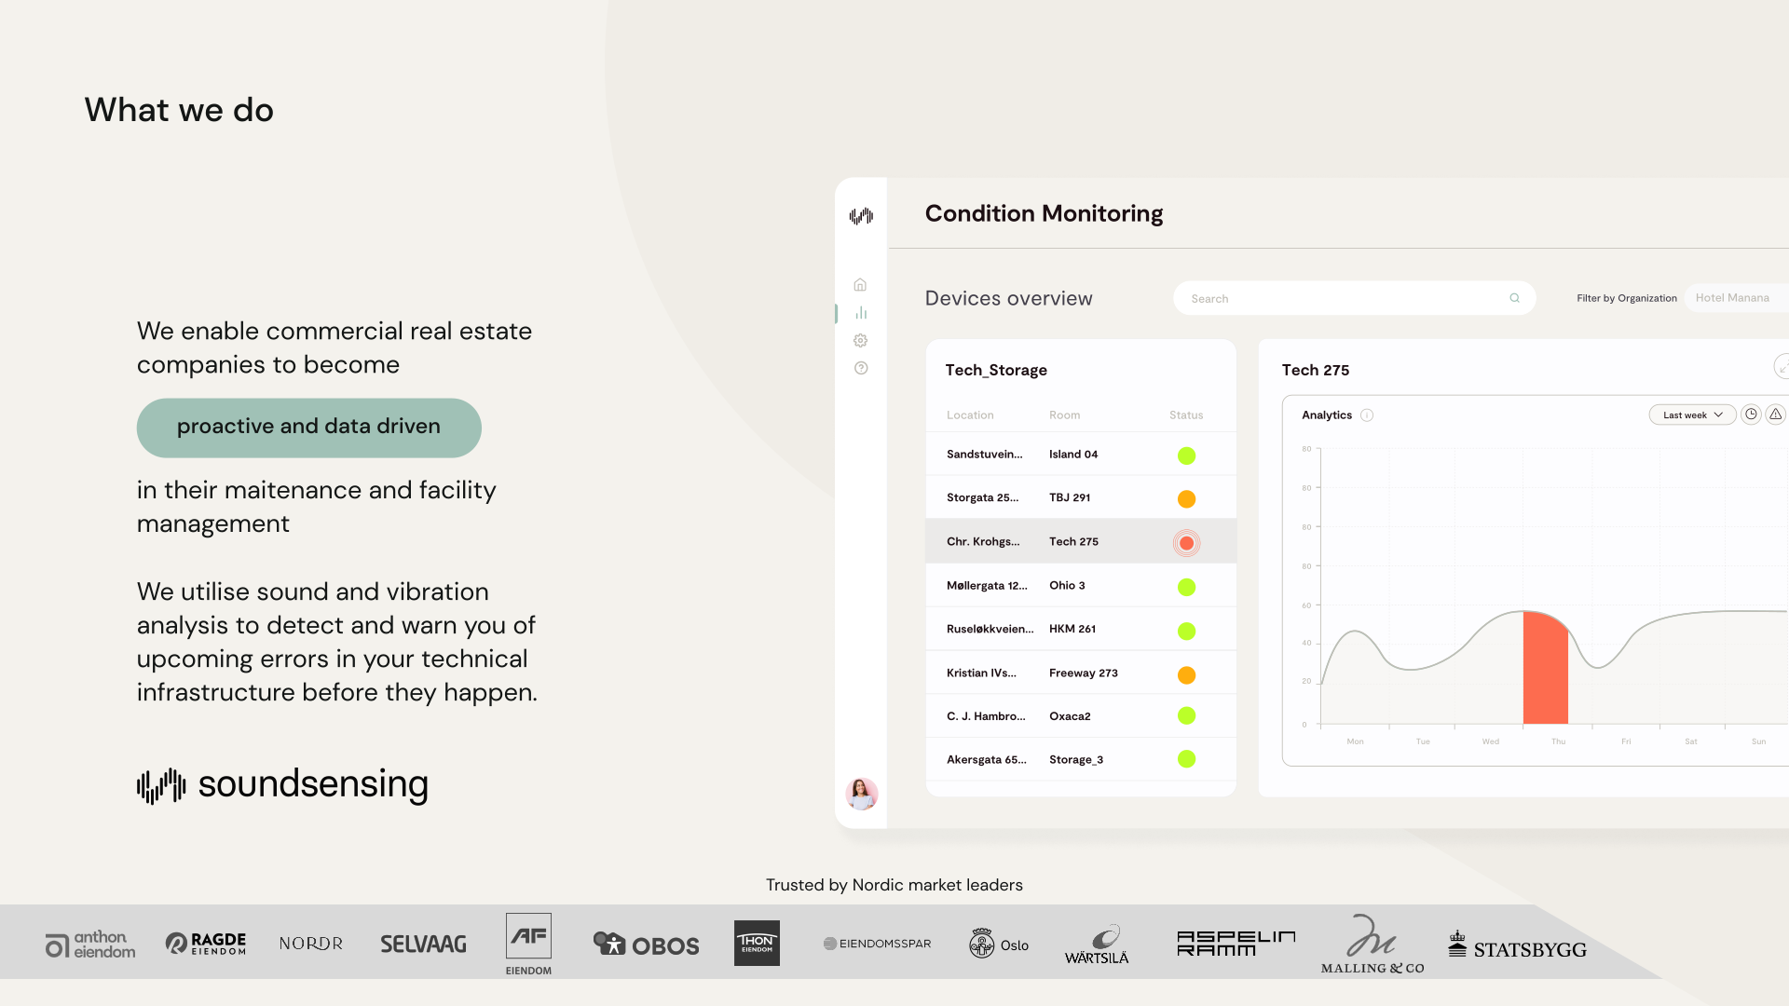
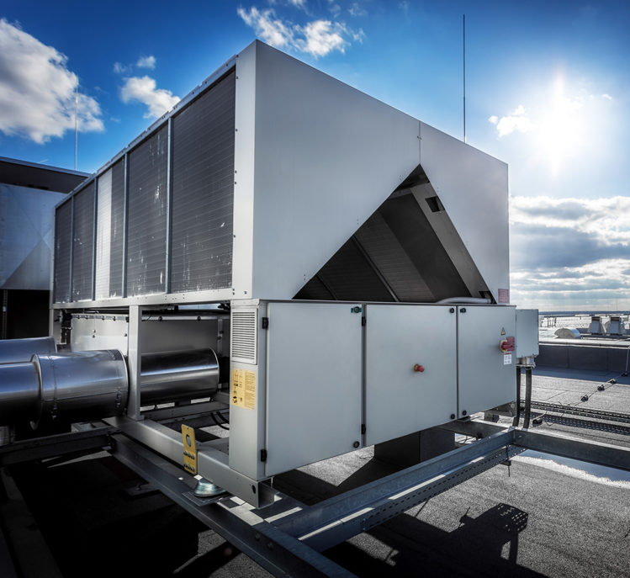
Notes:
Work as Head of Data Science at Soundsensing.
Soundsensing is a leading provider of predictive maintenance solutions for ventilation systems in buildings. So we work a lot with sensor data. And also use Python as much as we can for Data Science, IoT and backend tasks.

Slide 3
Goal
You as a Python developer
with some experience with standard Python ML libraries (scikit-learn/Keras)
can deploy Machine Learning models to a microcontroller device
using emlearn + MicroPython
Purpose of this presentation
Notes:
The goal of the presentation today is …

Slide 4
Outline / agenda
Background - microcontrollers, why Machine Learning
MicroPython - a Python for microcontrollers
emlearn - TinyML project
How to use emlearn with MicroPython
Notes:
As a brief structure of this presentation

Slide 5
Background

Slide 6
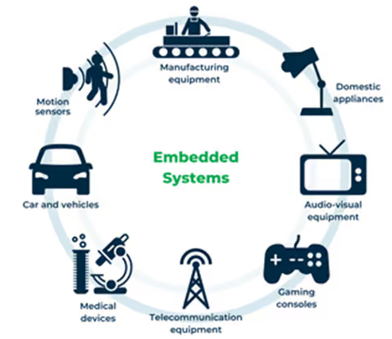
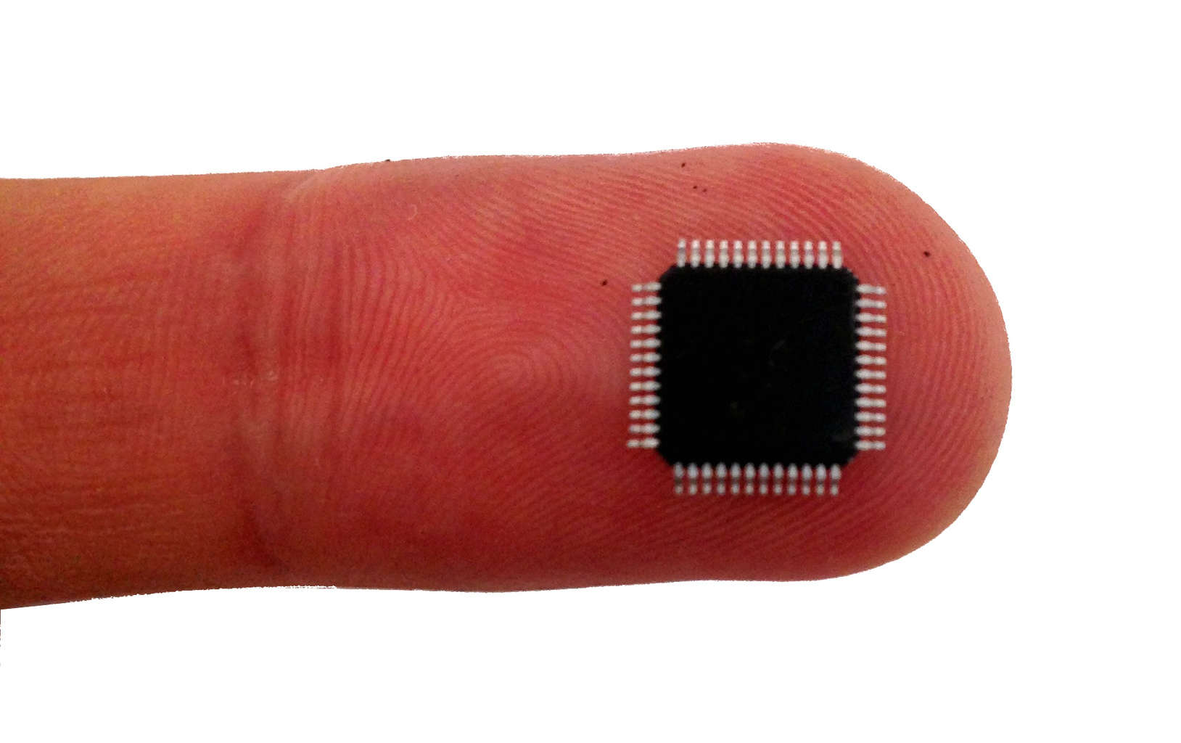
Microcontroller - tiny programmable chip
Compute power: 1 / 1000x of a smartphone
RAM: 0.10 - 1 000 kB
Program space: 1.0 - 10 000 kB
Compute 10 - 1000 DMIPS
Price: 0.10 - 10 USD
Over 20 billions shipped per year!
Increasingly accessible for hobbyists
2010: Arduino Uno 2014: MicroPython 2019: MicroPython 1.10 - ESP32 PSRAM
Notes:
Microcontroller is a small programmable chip.
That since the last 20 years provides the “brain” of basically any electronics device around us.
All the devices that you have in your home have 1 or more microcontrollers each.
A modern car has over 50 microcontrollers.
While they are mostly used for industrial application, they are increasingly accessible for hobbyists and semi-professionals. And today many of these devices can run Python! So in a way, you probably already know how to program them.

Slide 7
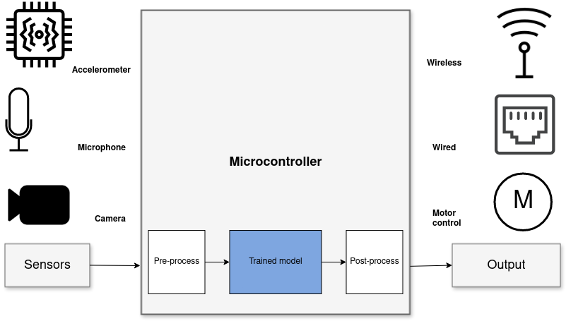
Sensor data analysis with Machine Learning
System diagram for “TinyML” solution
Benefits vs sending data to cloud
Stand-alone
Low latency
Power efficiency
Privacy
Low cost
Notes:
When it comes to Machine Learning on microcontrollers,
we are obviously not going to be running any Large Language Models or generative image models.
But one usecase where ML is incredibly useful is in analysing sensor data.
Sensors such as accelerometers, microphonones, radars, and cameras have gotten incredibly cheap and powerful.
But in order to get useful information out of these, the raw data must be processed.
Using Machine Learning, in combination with Digital Signal Processing, allows analyzing complex phenomena.
If this is done on the microcontroller, we get a range of benefits:
...
The component in blue is the Machine Learning model, and is typically trained ahead of time on a PC.

Slide 8
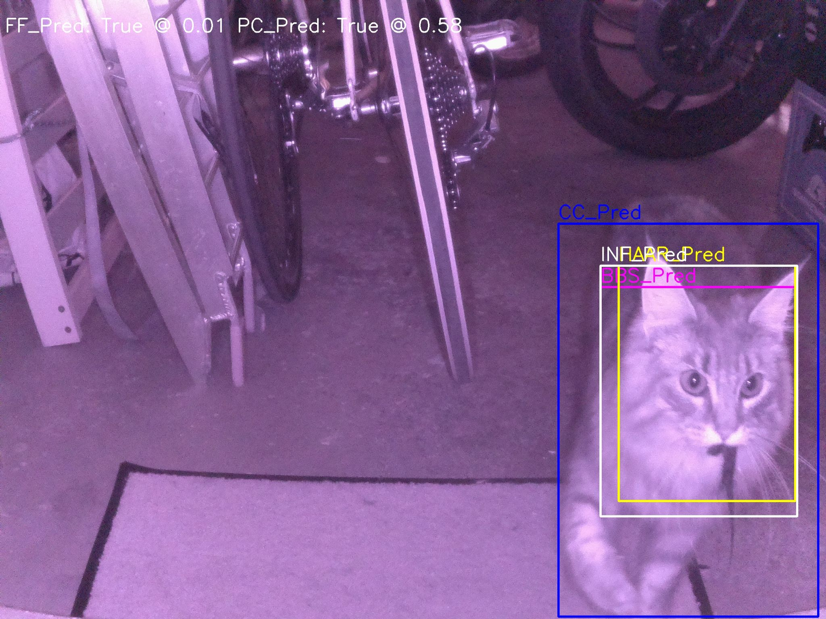
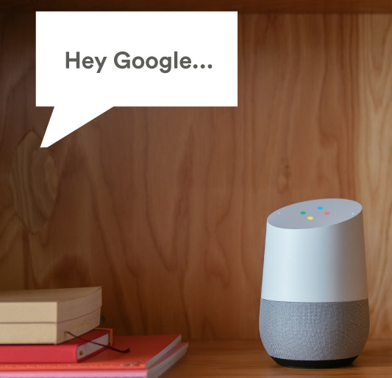
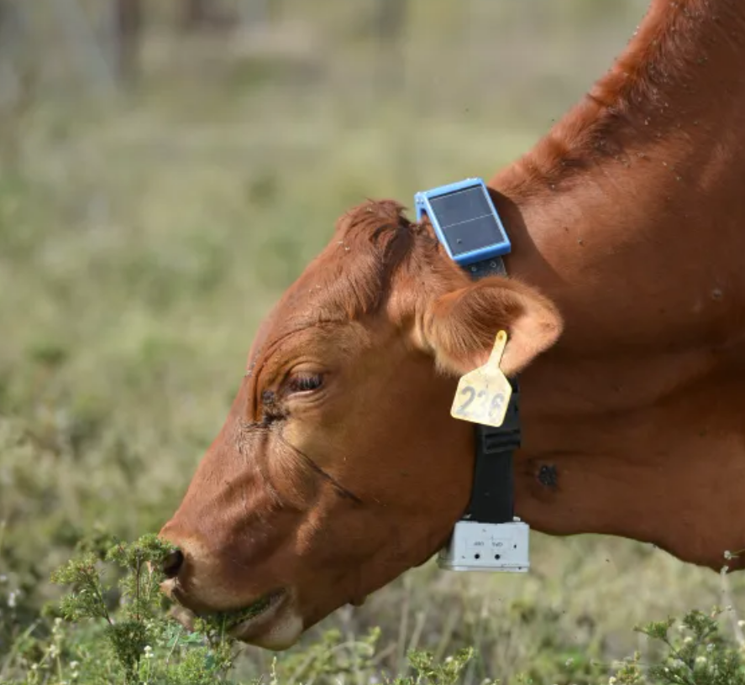
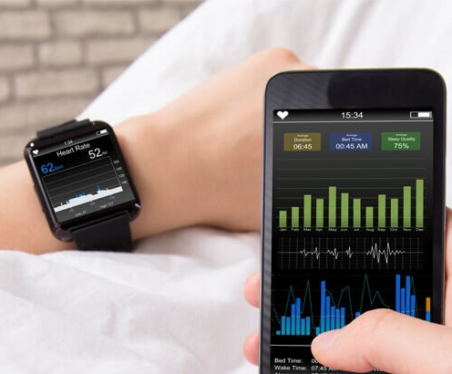
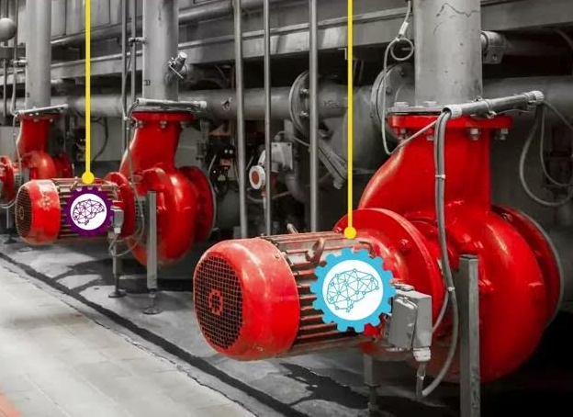
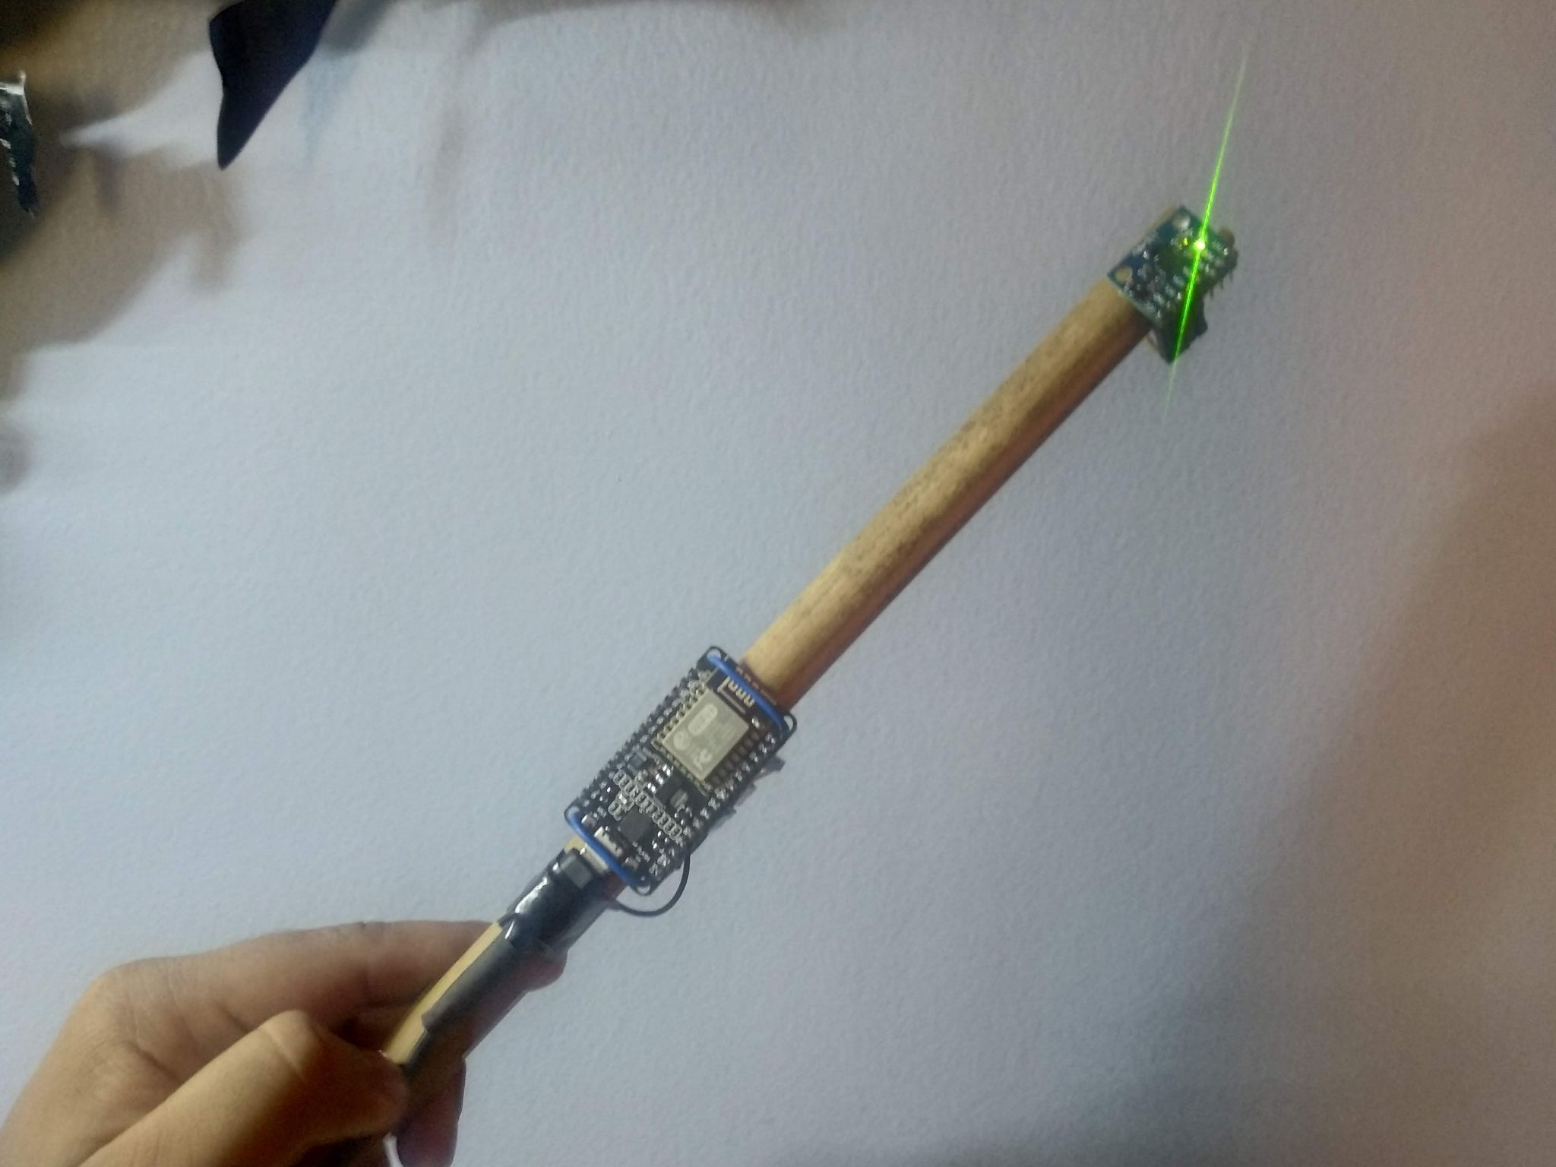
Applications
Consumer Tech
Industrial
Fun
Notes:
This is a huge amount of applications for this, in basically any field that uses electronics.
Keyword spotting / wakeword detection. “Alexa” Smartwatch. Sleep activity tracking Agriculture. Cattle activity tracking Condition monitoring of Machinery.
Or what about a cat doorbell that only lets in your cat, and only if it does not have a prey in its both. Magic wand.

Slide 9
emlearn
Machine learning for Microcontrollers and Embedded Systems
Notes:
Emlearn is an open-source library that helps to realizing such projects.

Slide 10
emlearn - Machine Learning for microcontrollers
https://github.com/emlearn/emlearn/
Convenient training
Model creation in Python
Use standard libraries
scikit-learn
Keras
One-line to export to C
Verification tools included
Embedded Friendly C code
Portable C99 code
No dynamic allocations
Header-only
High test coverage
Integer/fixed-point math *
Small. 2 kB+ FLASH
* Only some models
Notes:
emlearn is an open-source software library that can be used to implement such projects.
It provides embedded friendly implementations of Machine Learning models.
It supports converting models trained in Python.
Can either use scikit-learn or Keras.
The code is portable and clean C99.
It can be used on even the smallest MCUs,
as it does not need FPU, and the code size is very small.

Slide 11
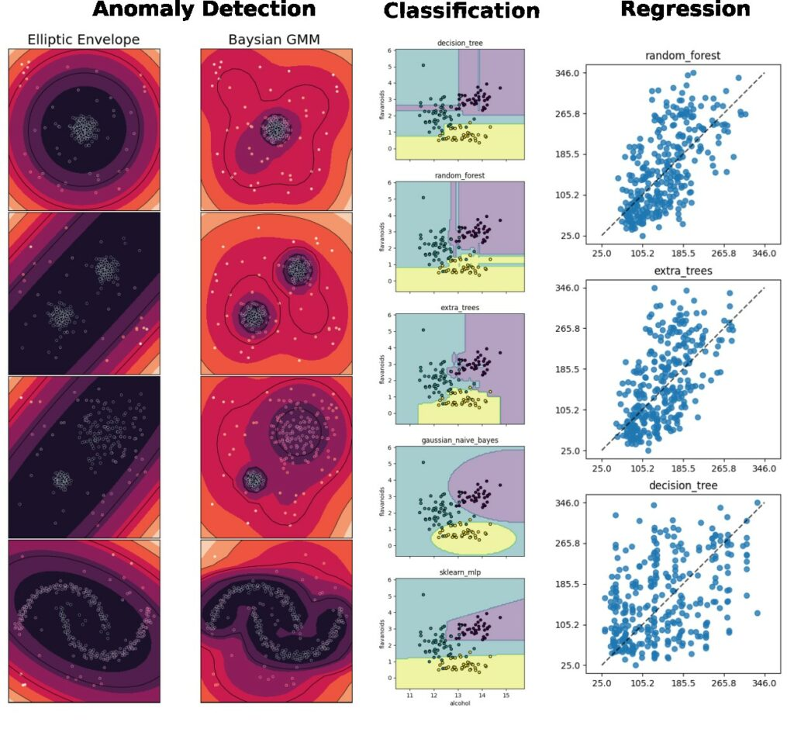
Supported tasks
Supports the most common tasks for embedded & sensor data usecases.
Classification
Regression
Anomaly Detection
Notes:
emlearn supports the three most common ML tasks:
classification, regression, anomaly detection.

Slide 12
Supported models
Selection of simple & effective embedded-friendly models
Decision Trees (DT)
Random Forest (RF)
K Nearest Neighbors (KNN)
Gaussian Mixture Models (GMM)
Multi-Layer-Perceptron (MLP)
Notes:
Supports a selection of embedded friendly models:
….

Slide 13
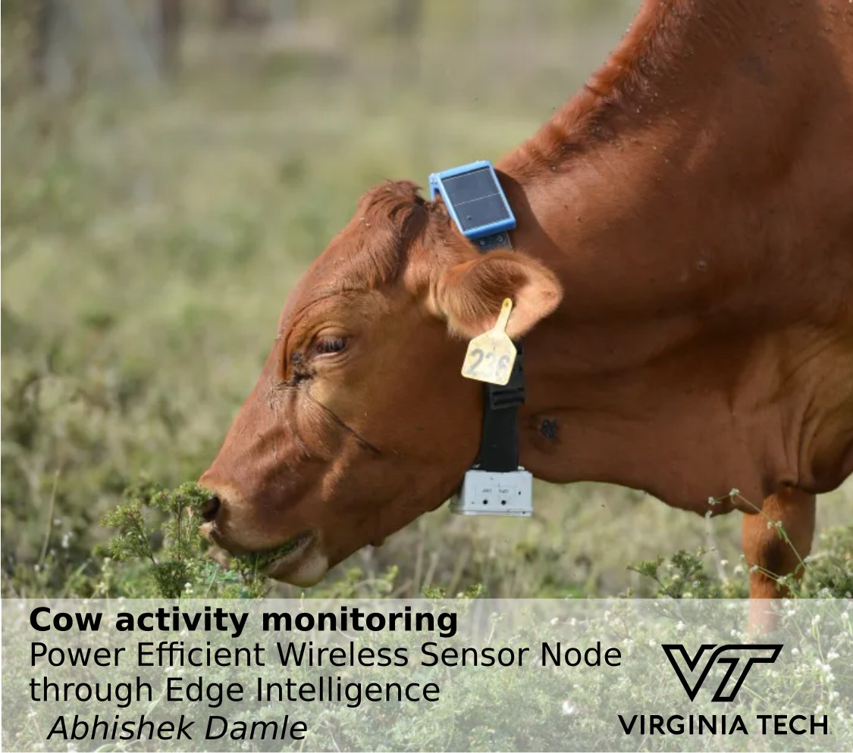
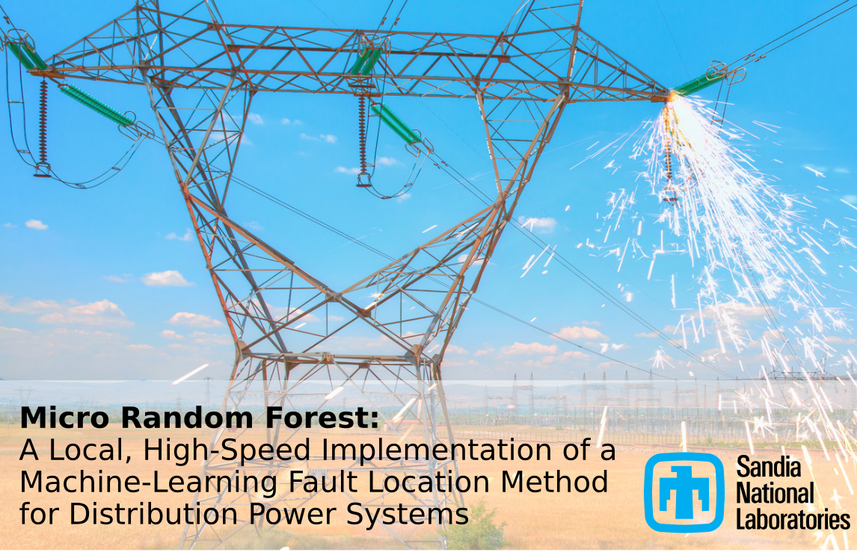
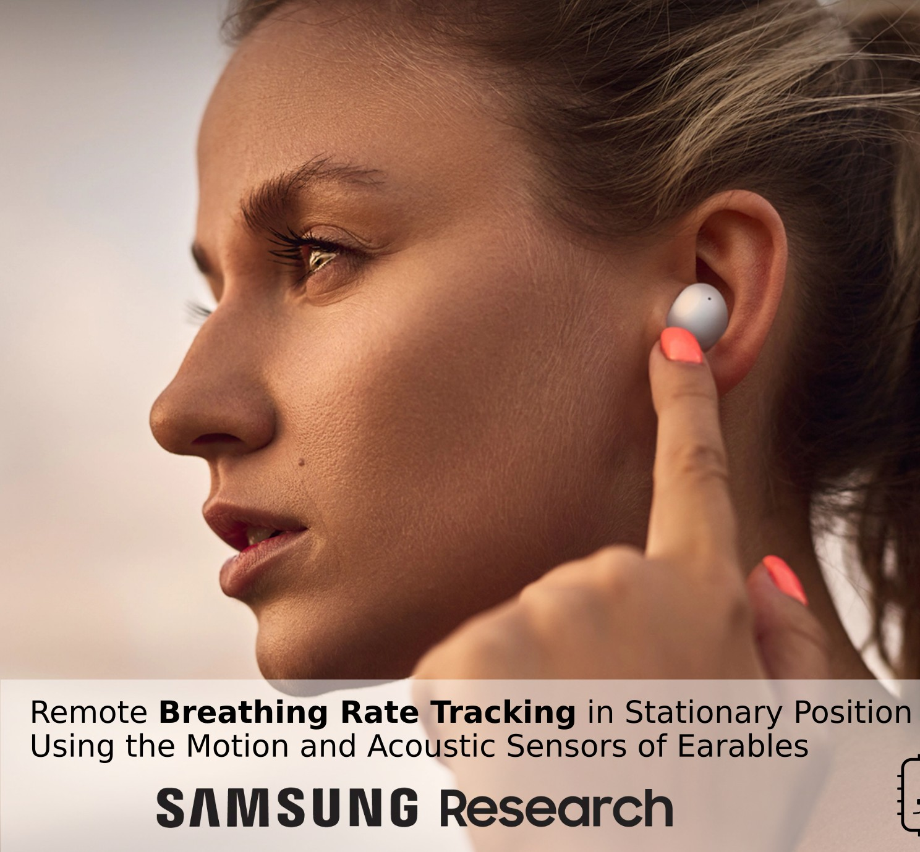
6 years of emlearn
Mature project. Used in 30+ RnD projects worldwide (published papers)
Notes:
The project was started in 2018 by me.
And has been maintained by me since that time. With a couple of contributors here and there. Quite mature. Has been used for dozens of projects across the world.

Slide 14
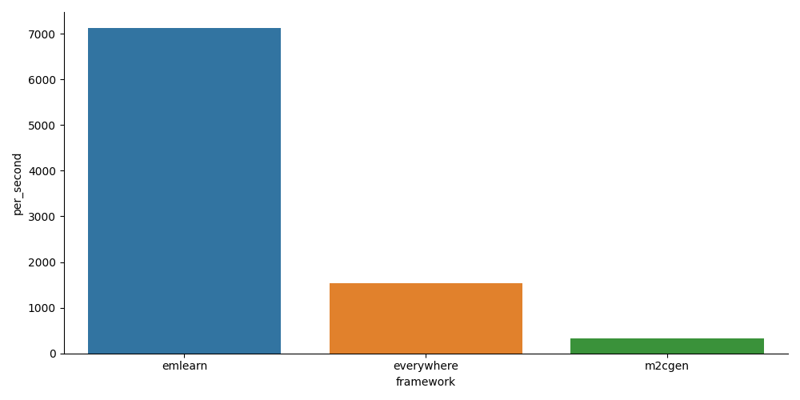
emlearn-micropython: MicroPython bindings for emlearn
https://github.com/emlearn/emlearn-micropython/
Combine the convenience, familiarity and productivity of Python - with the speed of C
Modules installable at runtime (.mpy)
Random Forest / Decision Trees
K Nearest Neighbors
IIR filters
Early development phase (start August 2023). Planned:
Multi-layer Perceptron
Convolutional Neural Networks

Slide 15

MicroPython
Python for your microcontrollers!

Slide 16
MicroPython introduction
Implements a subset of Python 3.x for devices with 16 kB+ RAM Supports 8+ microcontroller families
Tries to be as compatible as possible, within constraints.
Python 3.6 mostly implemented, partial after that. No CFFI or C module compatibility! TLDR: Small scripts will mostly work with minor mods. But not PyData stack
Package manager “mip install” Has support for loading C modules at runtime!
More info: https://micropython.org

Slide 17
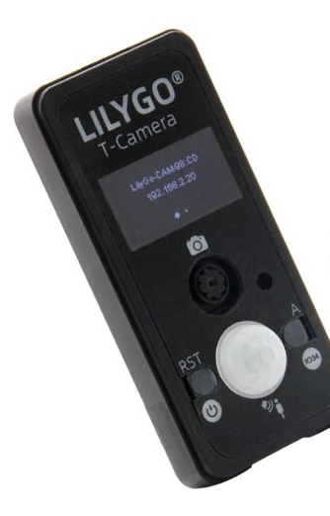
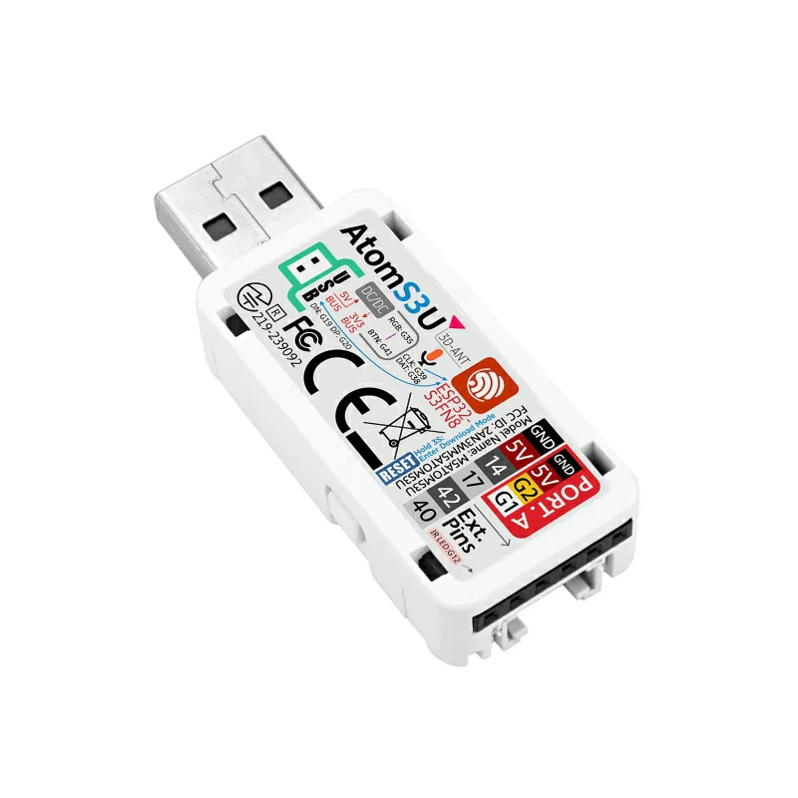
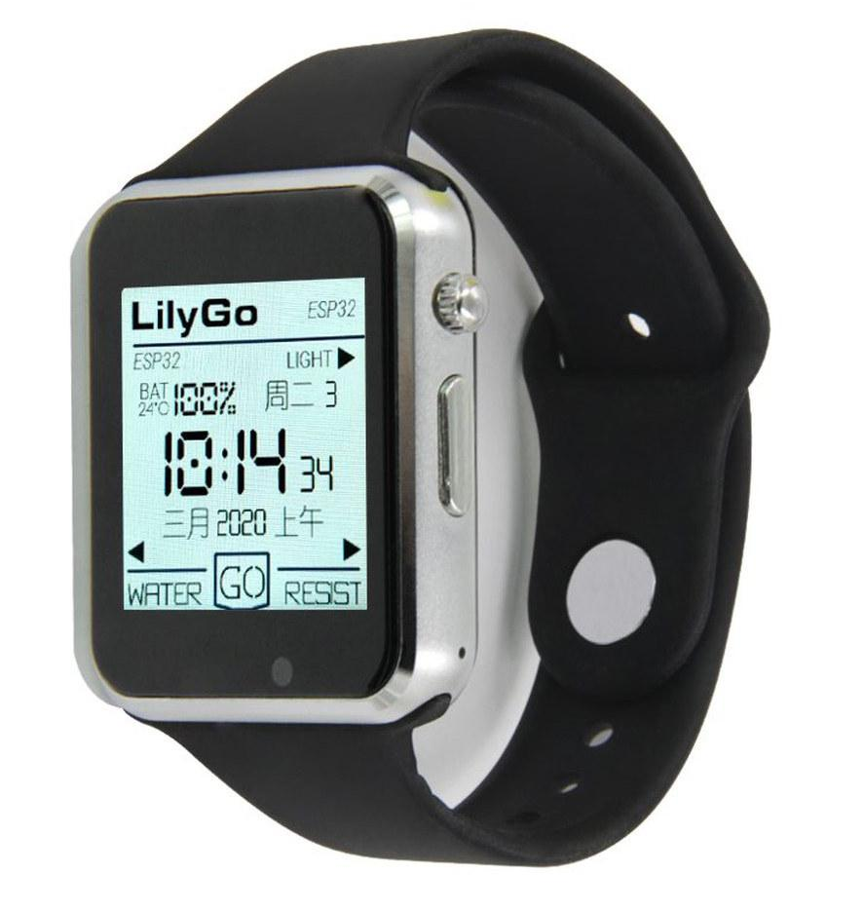
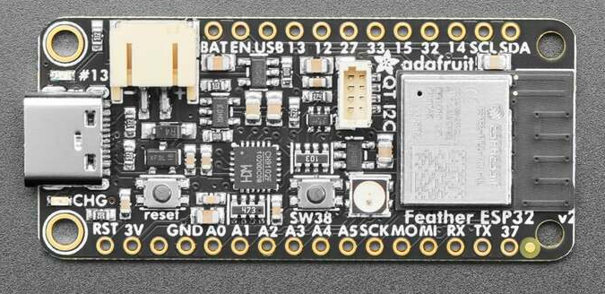
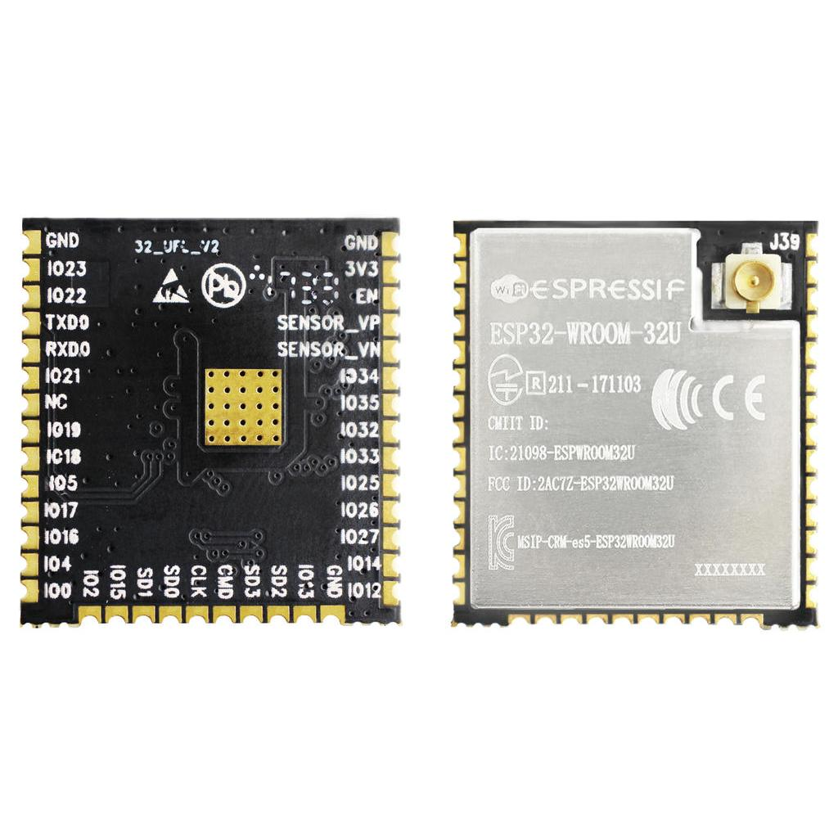
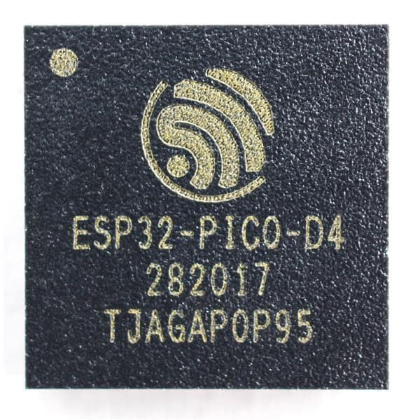
MicroPython Hardware recommendation Start with a ESP32 device
Complete devices: 20 - 50 USD Development boards: 5 - 20 USD
Chips / modules 1 - 5 USD
Notes:
?

Slide 18
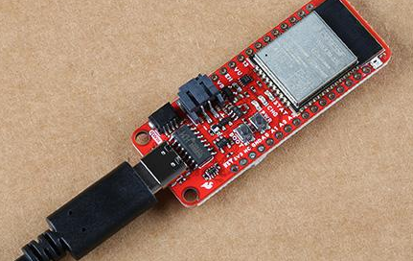
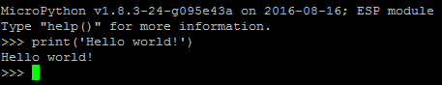
Installing MicroPython
Download prebuilt firmware https://micropython.org/download/?port=esp32
Flash firmware to device
pip install esptool
esptool.py --chip esp32 --port … erase_flash
esptool.py --chip esp32 --port … write_flash -z 0 micropython-v1.17.bin
Connect to device
pip install mpremote mpremote repl
IDE (optional): Thonny, VS Code, et.c.
Notes:
! drives for peripherals that are on a board not included in core firmware
Will likely need to hunt a bit for each sensor, screen etc

Slide 19
Making an ML application
using emlearn-micropython

Slide 20
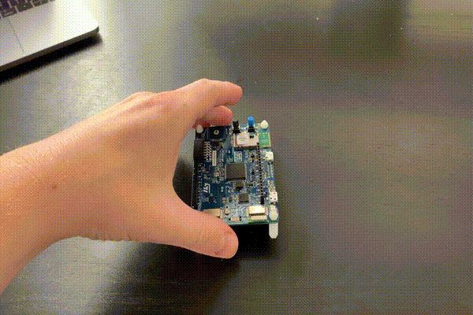
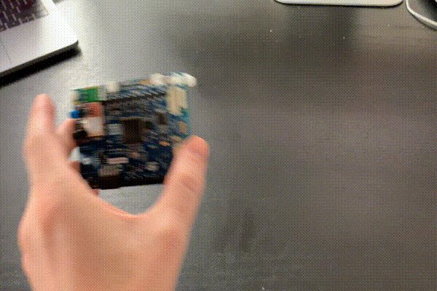
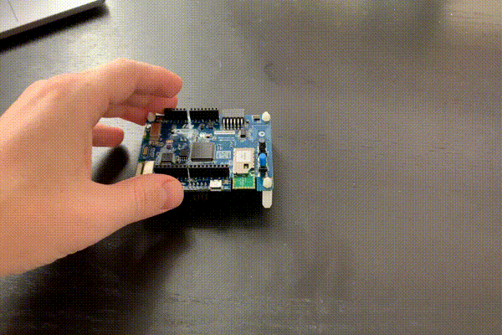
Overall process
0. Record & label training data
1. Install the libraries. On PC and on device
2. Train Random Forest model on PC
3. Export model as CSV file
4. Load model in MicroPython & run
Example project
Detect gestures from accelerometer:
Updown
Wave
Snake
Idle
For tutorial by EdgeImpulse

Slide 21
Record training data
Transmit over serial/USB to PC.
Store to local storage. Ex: Internal FLASH, SDCard, et.c.
Transmit wirelessly. Ex: WiFi + HTTP, BLE
def write_buffer_csv(buffer, file, rowstride = 3):
rows = int(len(buffer) / rowstride)
file.write('x,y,z\n')
for row in range(0, rows):
x = buffer[(row*rowstride)+0]
y = buffer[(row*rowstride)+1]
z = buffer[(row*rowstride)+2]
file.write('%.4f,%.4f,%.4f\n' % (x, y, z))
t = isoformat(rtc.datetime())
with open(data_dir + '/acceleration-'+t+'.csv', 'w') as f:
write_buffer(accel_buffer, f)
It is just Python (tm)
ESP32 has 8 MB internal storage - super convenient !
Notes:
Here is some example for saving our accelerometer data a CSV file I like to save to the internal file system. Zero setup More scalable would be to transmit over WiFi etc

Slide 22
emlearn-micropython: Installing
Install emlearn Python package on PC
pip install emlearn
Download and copy MicroPython library to device
curl https://emlearn.github.io/...../xtensawin_6.2/emltrees.mpy mpremote fs cp emltrees.mpy :
Future *:
mpremote mip install emltrees.mpy
* Needs native module and binary package support in mip repository
Notes:
mpremote fs cp
https://github.com/micropython/micropython/pull/13292

Slide 23
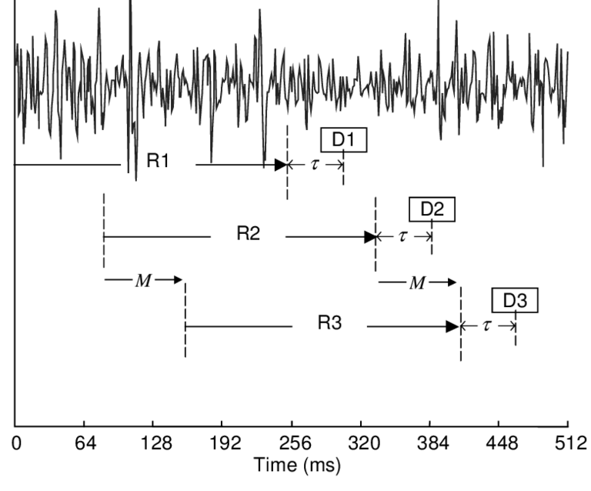
ML on streams: Continuous classification
The sensor data stream is sliced into overlapping windows
Each window is processed
Preprocess
Model
Raw sensor data
Features
Class
Notes:
The sensor data steam is conceptually infinite
The Machine Learning models on the other hand must have finite and fixed-length inputs
This is done by splitting the stream at fixed intervals of time. Into windows
Usually with some overlap. So model gets multiple chances at predicting the same phenomena

Slide 24
Sensor data readout in MicroPython
# Check if sufficient new data is available
if sensor.fifo_level() >= len(accel_buffer):
# Read raw data
sensor.fifo_read(accel_buffer)
# Check if window buffer is full. Shift old data over to make room for more
if window_offset == window_samples:
window[0:(window_samples-hop_samples)*3] = window[hop_samples*3:]
window_offset -= hop_samples
# Decode sensor data
decode_acceleration(sensor, accel_buffer, window, window_offset)
window_offset += hop_samples
# Preprocess features
preprocessor.run(window, features)
# Run model
out = model.predict(features)
Notes:
FIFO on accelerometer side Critical to

Slide 25
Feature engineering for accelerometer data
!!! Preprocessing must be compatible between host and device (CPython and MicroPython)
Best practice: Write preprocessor for MicroPython, re-use in Python A. import mypreprocessor.py
when using common MicroPython/CPython subset B. subprocess(‘micropython …’) if using MicroPython-specific features like Viper assembler

Slide 26
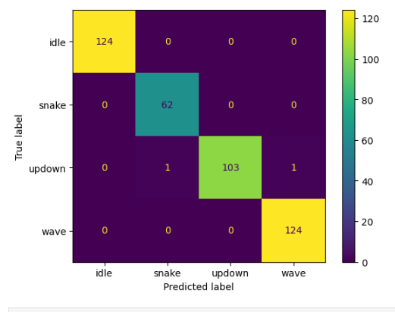
Training a RandomForest model
Standard process - familiar to anyone who has used scikit-learn.
But - Make sure model size is not huge.
# preprocess data
windows = train.groupby(....).apply(create_windows, length=int(2000/15), hop=int(260/16))
features = windows.groupby(...).apply(spectral_features)
# train model
from sklearn.ensemble import RandomForestClassifier
est = RandomForestClassifier(n_estimators=10, max_depth=5)
est.fit(features, features.reset_index()['class'])
# evalutate on test set …

Slide 27
emlearn-micropython: Export and load model
import emlearn
converted = emlearn.convert(estimator)
converted.save(name='gesture', format=’csv’, file='gesture_model.csv')
Export model on PC
Copy model to device
mpremote fs cp gesture_model.csv :
import emltrees
# Instantiate model. Capacity for trees, decision nodes, classes
model = emltrees.new(20, 200, 10)
# Load model "weights"
with open('gesture_model.csv') as f:
emltrees.load_model(model, f)
Load model on device

Slide 28
Summary
1. Machine Learning on microcontrollers (“TinyML”) is useful to extract information from sensor data
2. Current microcontrollers can run Python thanks to MicroPython
3. emlearn-micropython is ML library that is easy to use and high performance
Learn more: https://github.com/ emlearn/emlearn-micropython

Slide 29
Machine Learning on Microcontrollers
using MicroPython and emlearn https://github.com/emlearn/emlearn-micropython
Jon Nordby jononor@gmail.com
PyData Berlin / PyCon.de 2024

Slide 30
Bonus

Slide 31
TinyML for MicroPython - comparisons
Project | Deployment | Models | Size | Compute time
emlearn | Easy. Native mod .mpy | DT, RF, KNN | Good | Good
everywhereml | Easy. Pure Python .py | DT, RF, SVM, KNN, | High with large models | Poor
m2cgen | Easy. Pure Python .py | DT, RF, SVM, KNN, MLP | High with large models | Poor
OpenMV.tf | Hard. Custom Fork | CNN | High initial size | Good
ulab | Hard. User C module | (build-your-own) Using ndarray primitives | High initial size | Unknown (assume good)
Notes:
Benchmark vs other MicroPython approaches

Slide 32
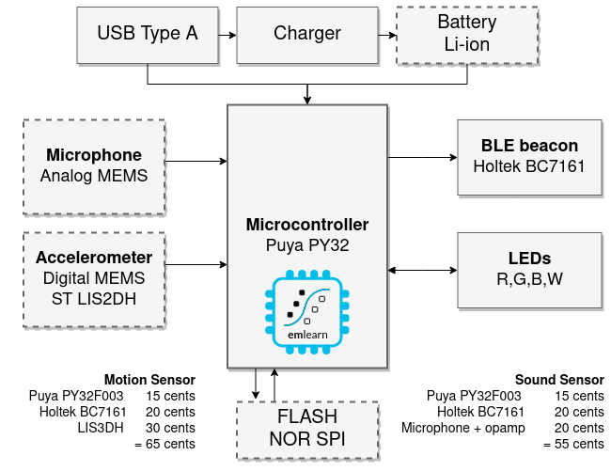
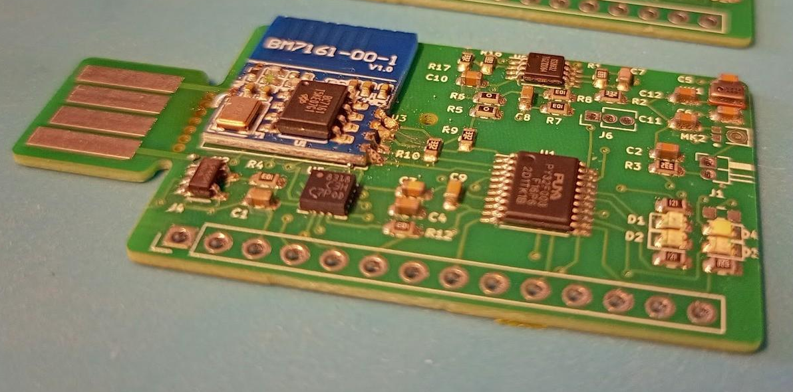
1 dollar TinyML system
Goal: Sound and accelerometer sensing using ML for under 1 USD in total component cost (BOM)
https://hackaday.io/project/194511-1-dollar-tinyml
Challenge: 3 kB RAM / 32 kB FLASH
Notes:
### Object detection

Slide 33
Labeling dataset
Use any standard labling tool.
Examples:
Label Studio: https://labelstud.io/

Slide 34
Task feasibility versus microcontroller type
 | RAM (kB) | FLASH (kB) | CPU (CoreMark) | MicroPython | IMU 100 hz 5 s | Sound 16 kHz 1 s | Image 64x64 px 1 fps
Arduino Uno ATMega 328 @ 16 Mhz | 2 | 32 | 4.0 |  | ✓ | ❌ | ❌
Arduino Nano BLE 33 NRF52840 ARM Cortex M4F @ 64 Mhz | 256 | 1 000 | 215 | Possible | ✓ | ✓ | ❌
Arduino Nano ESP32 ESP32-S3 @ 240 Mhz | 8 000 | 16 000 | 613 (per core) | ✓ | ✓ | ✓ | ✓
Notes:
Coremark Mega 7.03 https://github.com/PaulStoffregen/CoreMark https://www.eembc.org/coremark/scores.php
Accelerometers/IMU 100-1kHz. Every N seconds. Human Activity Detection Basically anything ?
Sound
Typ 16 khz. Not 48 kHz
Specialized detectors. 1-100 classes
Image/video.
Low resolution, low framerate.
Specialized detectors. 1-10 classes. Not ImageNet Classification and object detection. Edge Impulse FOMO OpenMV
https://docs.edgeimpulse.com/docs/edge-impulse-studio/learning-blocks/object-detection/fomo-object-detection-for-constrained-devices

Slide 35
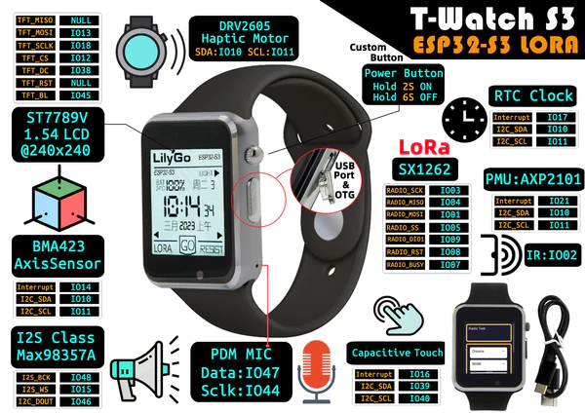
Python on your watch: the LilyGo T-WATCH S3
https://www.lilygo.cc/ products/t-watch-s3
Notes:
Not a daily driver as a watch For that, consider PineTime instead With wasp-OS (MicroPython based) https://github.com/wasp-os/wasp-os

